Slide 1
CSE 170 Technical Teamwork Communication
Twenty Minute Rant (by Ric Masten)
I have just wandered back into our conversation and find that you are still rattling on about something or other I think I must have been gone at least twenty minutes and you never missed me
now this might say something about my acting ability or it might say something about your sensitivity one thing troubles me tho when it is my turn to rattle on for twenty minutes which I have been known to do have you been missing too?
The mind is its own place, and in itself can make a Heav’n of Hell, and Hell of Heav’n – John Milton Paradise Lost

Slide 2
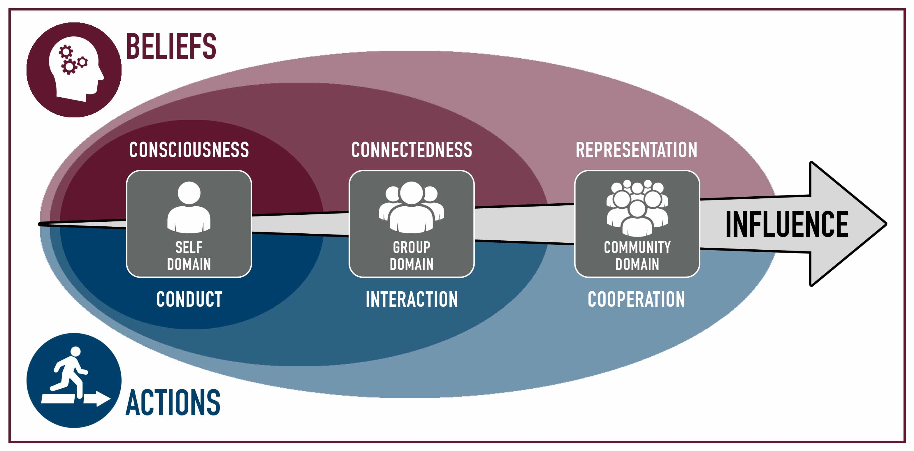
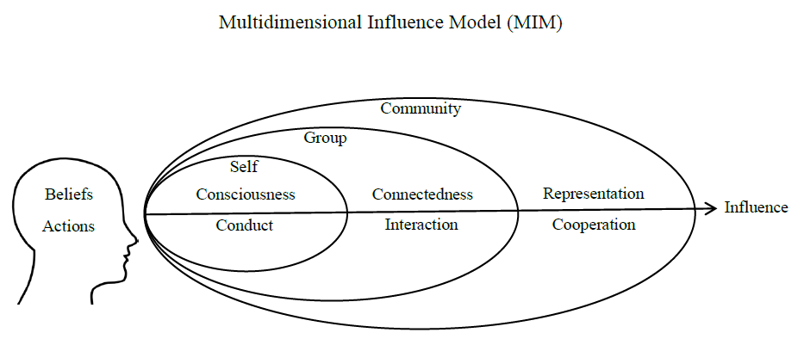
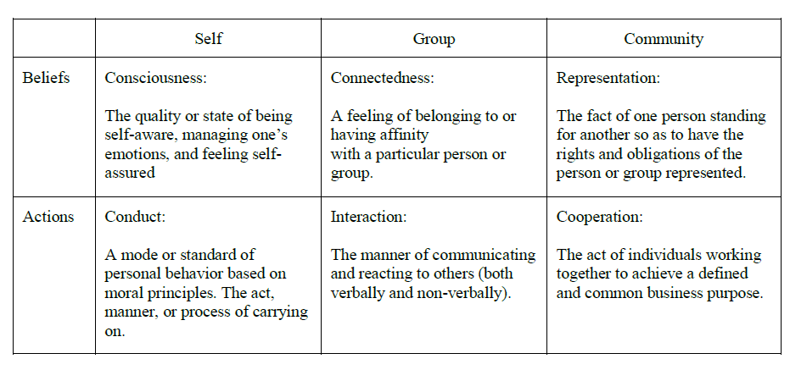
Class Organization
The class will be covering 4 modules/domains
Overview (Weeks 1-2)
Individual (Weeks 3-6) Personality, Motivation, Professionalism, Pressure
Group (Week 7-10) Commitment, Conflict, Technical Roles, Communication
(Not available, Under revision)
Community (Week 11-14) Leadership, Loyalty, Cooperation, Synergism
(Not available, Under revision)

Slide 3
Review
Week
1 | Overview |  | Teamwork
2 | Overview |  | Influence
3 | Personality | Individual | Consciousness
4 | Motivation | Individual | Consciousness
5 | Professionalism | Individual | Conduct
6 | Pressure | Individual | Conduct
7 | Commitment | Group | Connectedness
8 | Conflict | Group | Connectedness
9 | Roles/Ethics | Group | Interactions
10 | Communication | Group | Interactions
11 | Leadership | Community | Representation
12 | Loyalty | Community | Representation
13 | Cooperation | Community | Cooperation
14 | Synergism | Community | Cooperation

Slide 4
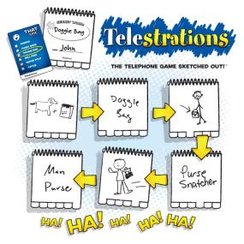
Game: Telestration
Each of you will start out with a word or phrase.
You will draw it and pass it to the next person.
The next person will then come up with a word that the picture depicts, and pass that word to the next person.
Then the next person draws the new word.
1. Draw (white), 2. Word(color), 3. Draw(white), 4. Word (color), 5. Draw(white), 6. Word (color), 7. Draw(white), 8. Word(color)
What can we learn from this game about communication?
Notes:
https://garticphone.com/lobby

Slide 5
Class Discussion
Effective Communication
Why is communication so important for technology professionals?
Can you think of an example of ineffective communication?
How can you be a more effective communicator?
Ethical Communication
What are the principles of ethical communication?
Why is it so important for professional relationships?
How does unethical communication undermine teamwork?

Slide 6
Professional Communication
As a group discuss the following
What are the different Communicative acts
What are the Different Kinds of Prof Communication
What are Principles of Communication
Draw a mind map of your ideas.
But before we start, a quick video…

Slide 7
90% of communication is body language
https://www.youtube.com/watch?v=CwzjlmBLfrQ
What body language is expressed in this video clip.
Write down words that express the different communication expressions/feelings.

Slide 8
Professional Communication
As a group discuss the following
What are the different Communicative acts
What are the Different Kinds of Prof Communication
What are Principles of Communication
Draw a mind map of your ideas.
Prepare to use one of those ideas to communicate to the class what you created

Slide 9
Professional Communication
Guided by Professional ethics
Communicative acts: verbal, written, electronic, non-verbal
Different Kinds of Prof Communication
Interviews: verbal, express yourself (experience, goals, attitude, ideas)
Verbal Communication: fluent, confident, occasion (mtg, lunch, events, help)
Public Speaking: presentation, teaching, age/audience
Written Communication: letters, memos, plans, policies, reports, publications
Digital Communication: Emails, networking, blogging, texting, conferencing

Slide 10
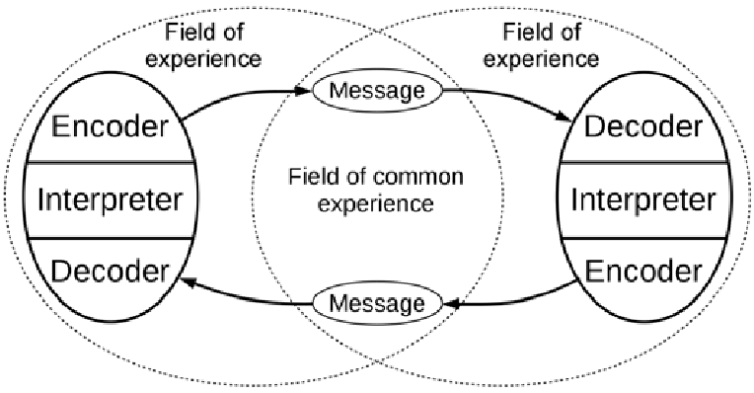
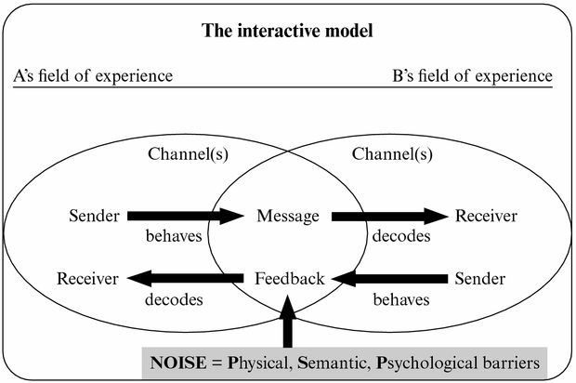
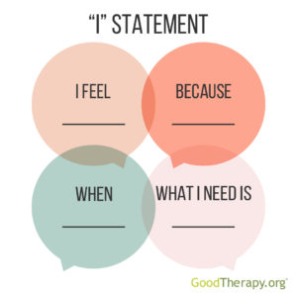
For example:
Notes:
https://www.researchgate.net/figure/The-interactive-model-of-communication-presented-by-Schramm-14_fig1_311739283
https://nursekey.com/communication-theory-and-its-applications-in-nursing-and-healthcare/

Slide 11
Ethical Communication
Ethical communication is a type of communication that is predicated upon certain business values, such as being truthful, concise, and responsible with one’s words and the resulting actions.
Fundamentals: Openness & Transparency
Roadblocks: Language Use, Jargon, Fluency, Technology
Relationship
Principles:
Truthful & Honest,
Active Listening,
Non-Judgmental,
Own Experience,
Preferred Communication Channel,
Strive to Understand,
Avoid Negative Tone,
Don’t Interrupt,
Respect Privacy and Confidentiality,
Accept Responsibility

Slide 12

ACM Code of Ethics and Professional Conduct
What communication tools are in the ACM code of Ethics?
1. General Ethical Principles
2. Professional Responsibilities
Contribute to society and to human well-being, acknowledging that all people are stakeholders in computing
Avoid harm.
Be honest and trustworthy.
Be fair and take action not to discriminate.
Respect the work required to produce new ideas, inventions, creative works, and computing artifacts.
Respect privacy.
Honor confidentiality.
Strive to achieve high quality in both the processes and products of professional work.
Maintain high standards of professional competence, conduct, and ethical practice.
Know and respect existing rules pertaining to professional work.
Accept and provide appropriate professional review.
Give comprehensive and thorough evaluations of computer systems and their impacts, including analysis of possible risks.
Perform work only in areas of competence.
Foster public awareness and understanding of computing, related technologies, and their consequences.
Access computing and communication resources only when authorized or when compelled by the public good.
Design and implement systems that are robustly and usably secure.

Slide 13
ACM Code of Ethics and Professional Conduct
What communication tools are in the ACM code of Ethics?
3. Professional Leadership Principles
4. Compliance with the Code
Ensure that the public good is the central concern during all professional computing work.
Articulate, encourage acceptance of, and evaluate fulfillment of social responsibilities by members of the organization or group.
Manage personnel and resources to enhance the quality of working life.
Articulate, apply, and support policies and processes that reflect the principles of the Code.
Create opportunities for members of the organization or group to grow as professionals.
Use care when modifying or retiring systems.
Recognize and take special care of systems that become integrated into the infrastructure of society.
Uphold, promote, and respect the principles of the Code.
Treat violations of the Code as inconsistent with membership in the ACM.

Slide 14
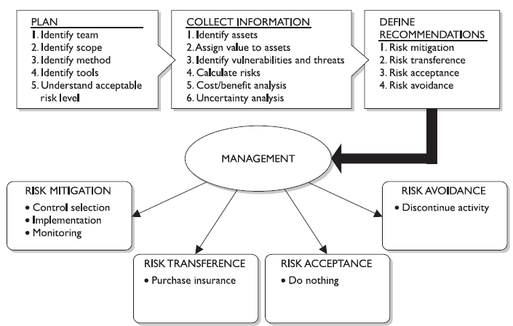
Risk Management
Different Mitigation
Prevention: Countermeasures
Transference: Insurance
Acceptance: Do Nothing
Avoidance/ Reject: Stop Activity
Things that we use Risk Management
To-do list: eliminate, automate, delegated, do it now
Pressure: Distraction, Breaks, Ask, Checklist
Team Conflict: ignore, complain, blame, deal
And Now…
Communication
Prevention:
Transference:
Acceptance:
Avoidance:
Prevention
------------

Slide 15
The Four Points of Practical Leadership Communication
Role
Communication skills are essential
Clearly/unmistakably
Environment
No distractions
Relaxed and alert
Positive
Gestures
Eye contact
Facial expressions
Posture
Dress/Look
Set the mood
Ice Breaker
Communication in Crisis
Stick to facts and issues
Rebuild trust
Best Method
Spoken, written, electronic
email vs phone call vs text vs face-to-face
Responsibilities
Good Listener
Think before speaking
Love & Care
Accept others as they are
Compliments and approval
Keep confidences
Properly phrase sentences
Message: Short, no errors, organized and to the point
Body Language

Slide 16
Review
Types of Communication
Method
Written
What we will be talking about…
Visual
Verbal
Bandwidth

Slide 17
Day2: Communication
Videos
Whatthisorgneeds
CommunicationLanguage

Slide 18

Going beyond Communication
Seeing what is not there, but the truth
Listening Continuum
Emotions and Communication
Beyond communication
Astrid part B
Improving team communication

Slide 19
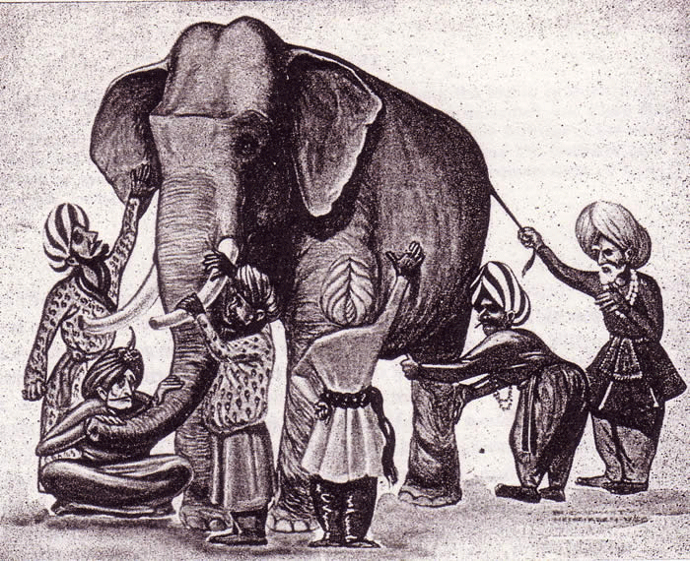
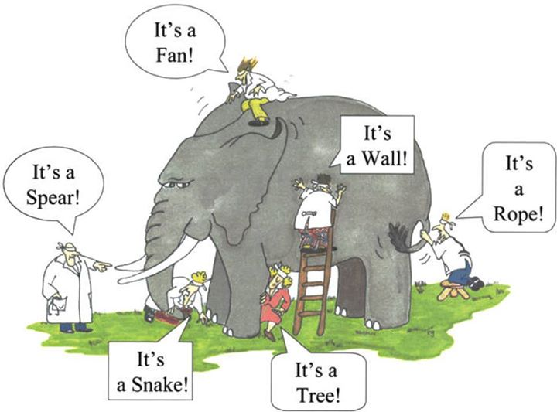
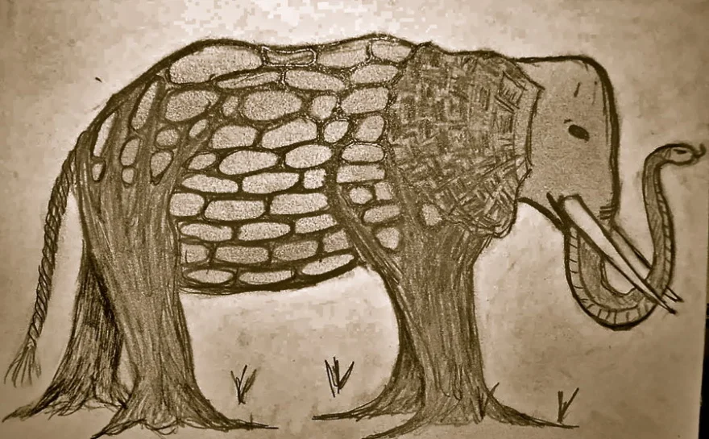
THE BLIND MEN AND THE ELEPHANT BY JOHN GODFREY SAXE
American poet John Godfrey Saxe (1816-1887) based the following poem on a fable which was told in India many years ago.
It was six men of Indostan to learning much inclined, who went to see the Elephant (though all of them were blind),that each by observation might satisfy his mind.
The First approached the Elephant and happening to fall against his broad and sturdy side, at once began to bawl:
“God bless me! but the Elephant is very like a wall!”
The Second, feeling of the tusk, cried, “Ho! what have we here, so very round and smooth and sharp? To me ’tis mighty clear,
This wonder of an Elephant is very like a spear!”
The Third approached the animal, and happening to take the squirming trunk within his hands, thus boldly up and spake:
“I see,” quoth he, “the Elephant is very like a snake!”
The Fourth reached out an eager hand, and felt about the knee.
“What most this wondrous beast is like is mighty plain,” quoth he;
“ ‘Tis clear enough the Elephant is very like a tree!”
The Fifth, who chanced to touch the ear, said:
“E’en the blindest man can tell what this resembles most; deny the fact who can this marvel of an Elephant is very like a fan!”
The Sixth no sooner had begun about the beast to grope, than, seizing on the swinging tail that fell within his scope,
“I see,” quoth he, “the Elephant is very like a rope!”
And so these men of Indostan disputed loud and long, Each in his own opinion exceeding stiff and strong, Though each was partly in the right, and all were in the wrong!
Moral:
So oft in theological wars, the disputants, I ween, rail on in utter ignorance of what each other mean, and prate about an Elephant not one of them has seen!
https://www.youtube.com/watch?v=hXiGaV8tY5M
Notes:
https://lynnwright00.wordpress.com/2012/02/19/the-blind-men-and-the-elephant/
https://audiophilestyle.com/forums/topic/54386-an-old-poem-from-the-orient-for-the-modern-audiophile/
https://www.patheos.com/blogs/driventoabstraction/2018/07/blind-men-elephant-folklore-knowledge/

Slide 20
Class Activity
Two Teams A &B
Team A: Your team’s object is to exactly duplicate a set of items arranged by Team B.
Each team will have one spokes person who will transmit the message to the other spokes person of the other team. (Written or Verbal)
“There are no restrictions on how to communicate assembly instructions.
But you will have only 10 minutes total to complete your task … beginning now.”
How well did you complete your task? Any challenges? Did you consider any other ways of communicating of sharing the vision?

Slide 21
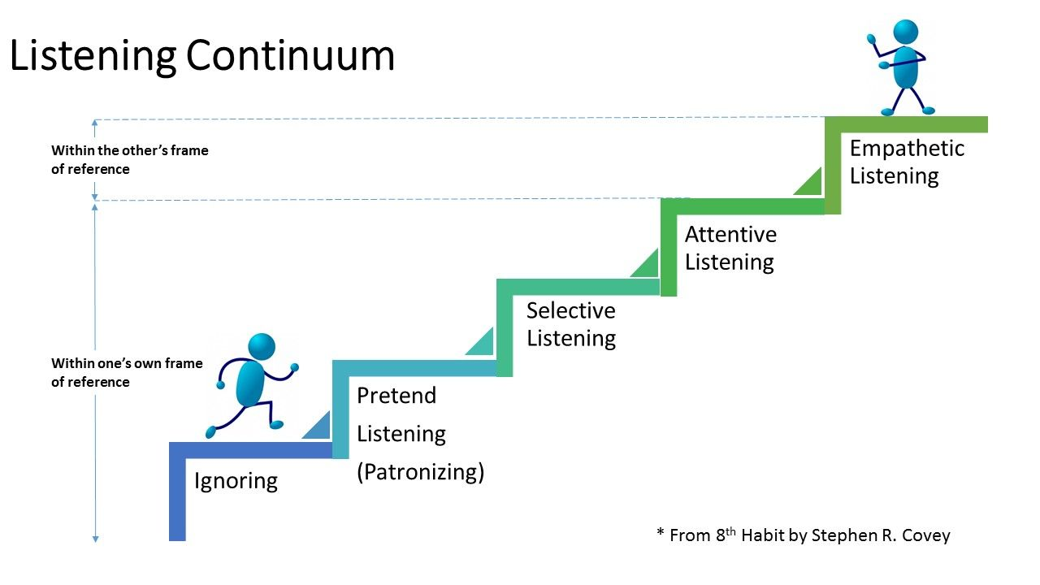
Notes:
https://www.pinterest.com.au/pin/322148179587156195/

Slide 22
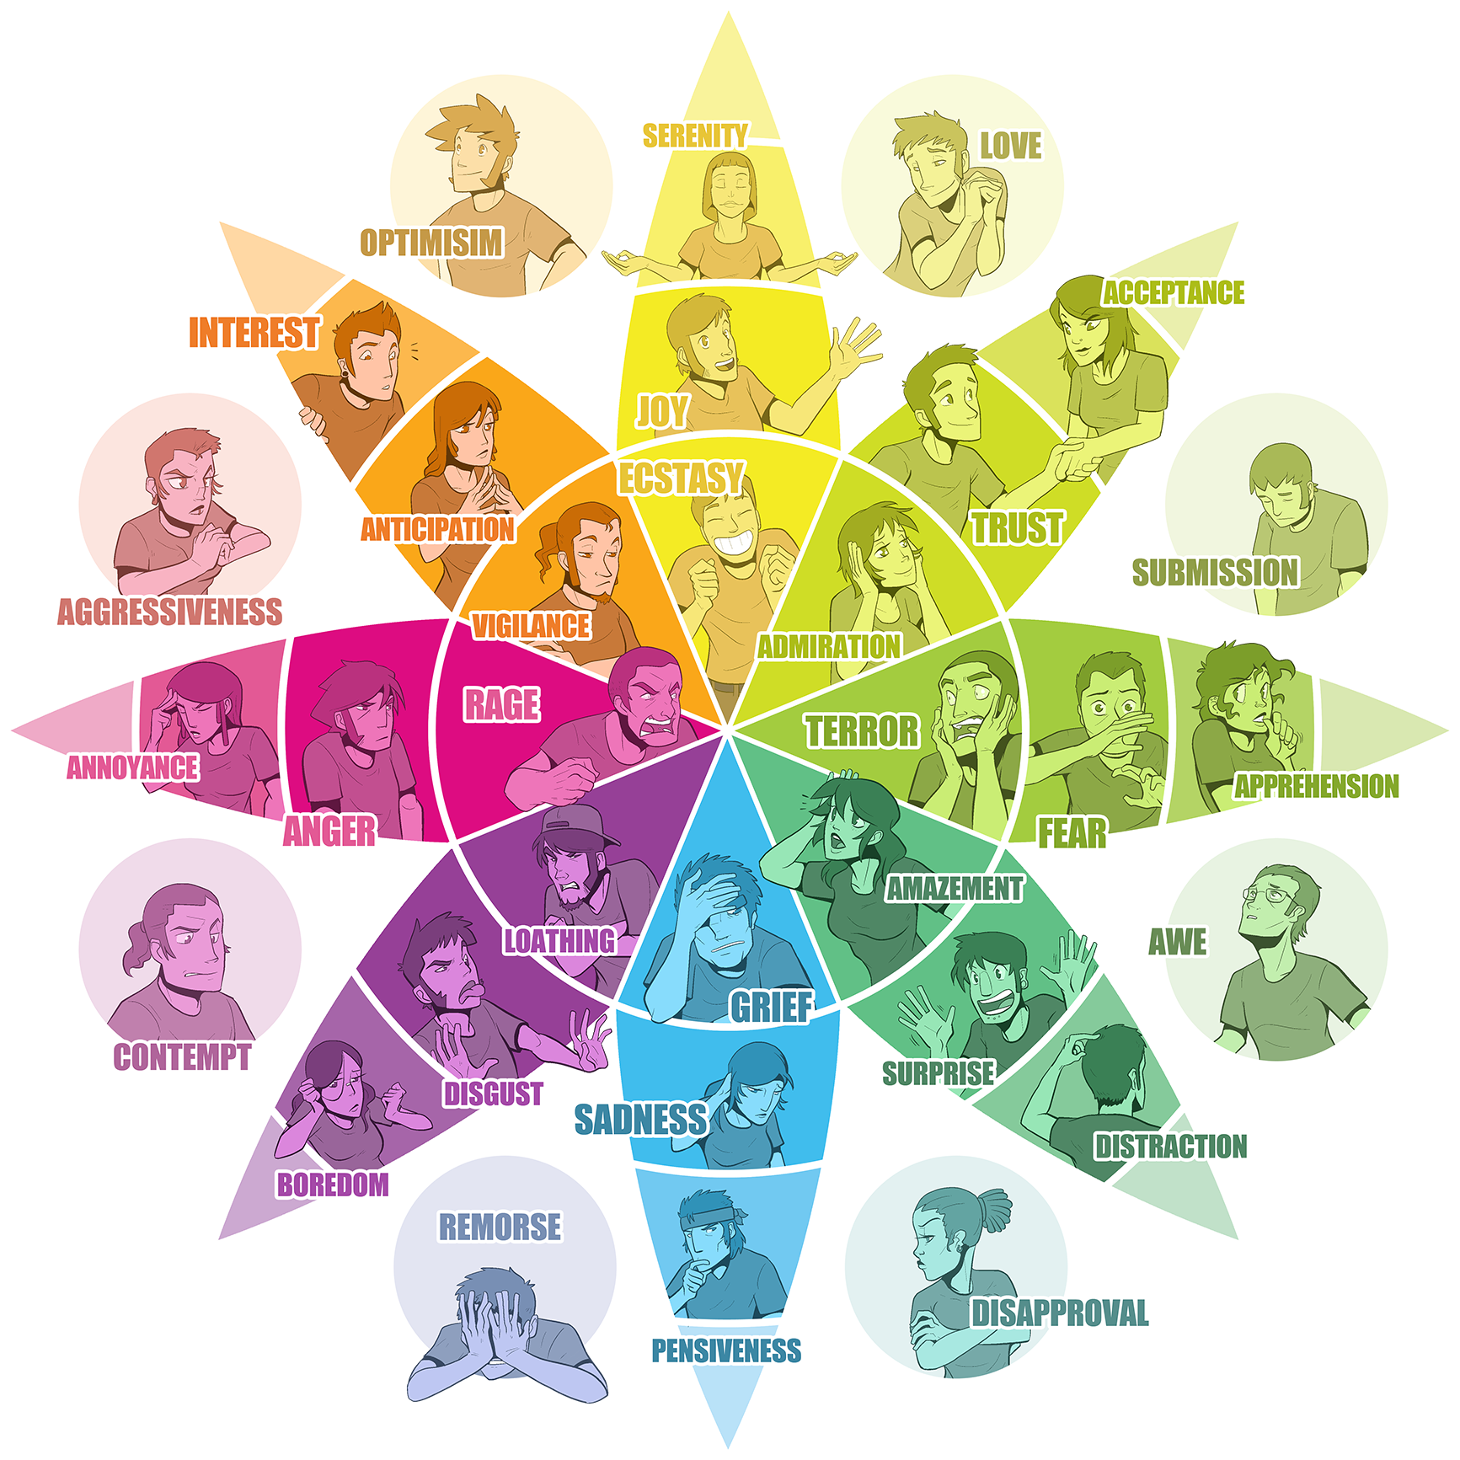
Emotions and Communication
Notes:
Image: Twelve Things Great Communicators Do https://slideplayer.com/slide/15508241/

Slide 23
Teamwork Equals Teamwork and Collaboration
Definition of Teamwork:
Definition of Collaborative Teamwork:
Communication-> Cooperation-> Coordination-> Teamwork-> Collaboration
How does the purpose and dependance differ?

Slide 24
Teamwork Equals Teamwork and Collaboration
Failures
Good Communication
Forcing collaboration
A Bad Team History
Poor Relationship
Ineffective Meetings
No Transparency/Info Sharing
No Governance
Conflicting Styles Decision Making
Behind-the-scenes
Competition
Turf Wars
Poor Ownership
Relate their message to their listener on a personal level
Always provide factual information
Give specific information in a brief manner
Ask questions to ensure understanding
Ask questions for clarification
Listen actively
Look for nonverbal cues

Slide 25
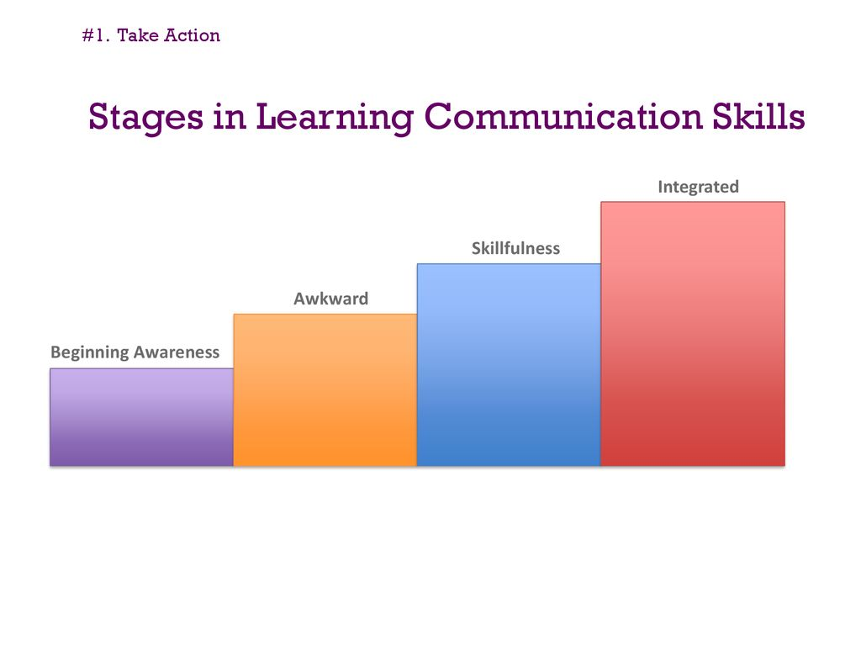
Teamwork Equals Teamwork and Collaboration
Is Collaboration a Skill?
How Do You Foster Teamwork?
Communication
Tolerance
Compromise
Authenticity
Teamwork
Consistency
Reliability
Recruiting: bandwidth
Leader Choice: task-oriented
Executive Sponsorship: support structure
Human Resources Practices: train
Mentoring and Coaching: soft skills
Model Collaboration: open culture
Cultivate Your Community: spirit
Develop Something Unique for Your Business: breaking role boundaries

Slide 26
Hyun Lee
Jed Olson
“If you find similar interests in growth, you can push each other to the fullest. I think ‘inspiring’ is hard to do every day. You must find common ground with your team and work together to achieve a common goal. Work with people's strengths and make sure the weaknesses are covered!
Play to strengths and cover weaknesses.”
Recommend: Care, Commission, Communicate, Contrast, Examples of Failure
Joshua Jarvis
The number one thing any team can do (and it's the thing that works only as high as you take it) is build trust. Communication is huge and that's likely the kind of answers you will get, but communication like that only comes from trust.
Lana Moore
Without goals and specific, measurable, attainable, realistic, and timeline objectives, it’s easy to veer off path and get caught up chasing what’s urgent instead of focusing on what’s important.

Slide 27
Dr. Janice Presser
Don Barlow
“People like best what they do best, and they do best what they like best,”
“The most important thing to have when developing a collaborative culture is a clear understanding of teaming needs and challenges, and the most important thing(s) to look for are the teaming qualities that will ensure success under those working conditions. To build positive, collaborative team interaction it is essential to recognize that a team has a life of its own, and that different modes of teaming can be just as important to collaboration and productivity as different areas of expertise are to the work that needs to be done.”
Below are a few tips that I have found useful in fostering team collaboration:
• Tip 1: First, make sure to communicate what constitutes the company’s standard of collaboration.
• Tip 2: Set mile markers for the team’s success.
• Tip 3: Create an atmosphere that allows for creativity.
• Tip 4: Build on team trust, and get to know individuals’ strengths.

Slide 28
Rick Lepsinger
Alec Sears
It is not enough to tell team members they need to collaborate.
Managers need to put things in place to motivate people to collaborate and to enable them to work effectively together.
Give Your Team a Chance to Bond
Establish Effective Communication Channels
Make Meetings Meaningful:
Brian Saab
We found that the best way to inspire people to collaborate is through democratizing project information. By making everyone aware of what is going on and giving them the software to interact with that knowledge, you create a shared sense of responsibility and openness that breaks down defensive communication and builds up positive collaboration.
Rohit Keserwani
When it comes to developing a team spirit, any activity that requires collaboration among many people will do. It includes everyday activities like cooking together for the group or cleaning the office. Most of the organizations organize easy, accessible, inexpensive, yet fun events like office decoration competition to engage the employees in team building".

Slide 29
Jodie Shaw
"I like to build a collaborative workplace by having every new team member complete a behavioral assessment (DISC).
Ajay Prasad
Inspire a team to collaborate is to explain the task at hand
Build atmosphere within the team
Respect, openness, and support are extremely important to establish in a team
Roger Wolkoff
The first thing I always do is get teams to trust [each other].
Know your role on the team
Stand by what you say
Get out of the way
Be a cheerleader
Christine Dura
Collaboration is the most effective method of problem solving
Right environment
Right tools
Collaborative leaders
Energize teams, encourage creativity, and promote workers’ production and level of satisfaction,
Ryan Matzner,
From there, we mix people across projects, making sure we rotate new people in and out so you are always working with a new group of colleagues

Slide 30

Communication and Teamwork
What are some communication
Techniques?
Tools?

Slide 31
Recall Astrid Angevin: Part B
Call in to Paul Johnson’s office – head of security
The Interview
As Paul wrote down her responses, Astrid thought about her experience with Govind and Rita’s desktop. She wondered how much she should share about that day. After all, they weren’t on the same team anymore. It really didn’t have anything to do with her. Astrid’s thoughts also turned to her current development team. She knew just how she’d feel if Rita and Govind were monitoring any of them. She decided to recount the whole experience, finishing with her call to the ethics hotline.
Second Interview
"I wanted to tell you that we confirmed your call to the ethics hotline. You’re very thorough with your notes Astrid…Keep up the good job”
Astrid was relieved. She thanked Paul and started back to her office. Astrid was surprised a second time that day as she passed Govind in the hallway. He didn’t say anything to her. He just frowned.

Slide 32
Astrid Angevin: Part B
Unethical Communication
What was the cause of Astrid's current situation?
Was Govind an ethical or unethical communicator? Why?
How did Govind's actions contribute to the situation?
Effective Communication
Was Astrid an effective communicator? Why or why not?
Was Astrid an ethical communicator? Why or why not?
What did Astrid do that helped her resolve the situation?
Communication & Teamwork
Who was the most professional communicator in this case? Why
How did communication skills influence the overall outcome?
Do you think Astrid will be successful with her new team? Why?
Professional ethics
Business values

Slide 33
Making Virtual Teams Work: Ten Basic Principles
Get
Get the team together physically early-on
Clarify
Clarify tasks and processes, not just goals and roles.
Commit
Commit to a communication charter.
Leverage
Leverage the best communication technologies.
Build
Build a team with rhythm.
Agree on
Agree on a shared language.
Create
Create a “virtual water cooler.”
Clarify and track
Clarify and track commitments.
Foster
Foster shared leadership.
Don’t forget
Don’t forget the 1:1s.

Slide 34
15 Simple Ways To Improve Team Communication
1. Have An Open-Door Policy. It Builds Trust.
2. Be Open to Reciprocal Feedback
3. Be Clear about Tasks So Everyone’s Knows Their Responsibility
4. Do Fun Stuff To Boost Morale
5. Give Purpose To Coffee Breaks
6. Communications Training Will Reset Your Team
7. Decide What Form of Communication Works Best
8. Utilize Project Management Software For More Transparency
9. Identify Group Leaders…And Support Them
10. Understand Diversity Issues
11. Point Out Individual Strengths And Use Them Well
12. Be open and honest with your team members
13. Take Advantage of Mobile
14. Make A Survey. Make It Anonymous
15. Take Ownership For Mistakes

Slide 35
“The many meanings of ‘I Love You’"
'I love you' is a statement that can be expressed in so many varied ways.
It may be a stage song, repeated daily without any meaning, or a barely audible murmur, full of surrender.
Sometimes it means I desire you or I want you sexually.
It may mean I hope you love me or I hope that I will be able to love you.
Often it means it may be that a love relationship can develop between us or even I hate you.
Often it is a wish for emotional exchange I want your admiration in exchange for mine or I give my love in exchange for some passion or I want to feel cozy and at home with you or I admire some of your qualities.
A declaration of love is mostly a request I desire you or I want you to gratify me, or I want your protection, or I want to be intimate with you or I want to exploit your loveliness.
Sometimes it is the need for security and tenderness, for parental treatment.
It may mean my self love goes out to you.
But it may also express submissiveness please take me as I am, or I feel guilty about you, I want, through you, to correct the mistakes I have made in human relations.
It may be self-sacrifice and a masochistic wish for dependency.
However, it may also be a full affirmation of the other, taking the responsibility for mutual exchange of feelings.
It may be a weak feeling of friendliness, it may be the scarcely even whispered expression of ecstasy 'I love you, ' - wish, desire, submission, conquest it is never the word itself that tells the real meaning here.
Dr. Joost A. M. Meerloo, MD

Slide 36
